Slide 1
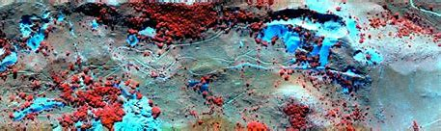
HYPER SPECTRAL ANOMALY DETECTION
Under The Guidance Of: Presented By:
Mrs. M. Jyothi Rani R Sivaram [4511-19-733-008]
M Shiva [4511-19-733-041]
B Srivani [4511-19-733-004]

Slide 2
CONTENTS
OVERVIEW
ABSTRACT
INTRODUCTION
EXISTING SYSTEM
PROPOSED SYSTEM
SYSTEM REQUIREMENTS
SYSTEM ARCHITECTURE
MODULES
UML DIAGRAMS
CONCLUSION
FUTURE SCOPE
REFERENCES

Slide 3
OVERVIEW
Hyperspectral remote sensing has become one of the frontier remote sensing earth observation technologies [1].
Hyper Spectral images (HSIs) are of wide spectral range and high spectral resolution, so it contains rich spectral information to discriminate physical properties of different materials [2].
Therefore, HSI finds many applications in different areas, such as land cover [3] classification, urban change detection, and crop monitoring.
By considering the limitations and drawbacks of the “Otsu based Isolation Forest” method, we propose a new anomaly detection method for hyperspectral images via Background and Potential Anomaly Detection in order to effectively detect an anomaly and eliminate the influence of noise.

Slide 4
ABSTRACT
Hyperspectral anomaly detection involves in many practical applications. The article “Hyperspectral Anomaly Detection With Otsu-Based Isolation Forest” proposes an Otsu-based isolation forest method. These method trains an isolation forest by assembling multiple binary trees. To construct a more discriminative binary tree, Otsu-based splitting criterion is applied to split subsamples into two groups at each division. Then, it feeds each tested pixel into isolation forest and obtains its anomaly score via the average path length throughout isolation forest. Considering the pixels with anomaly attribute values, path length refinement strategy based on distance weight is applied to better distinguish anomaly scores of tested pixels. In this project, By considering the limitations and drawbacks of the aforementioned method, we propose a new anomaly detection method for hyperspectral images via Background and Potential Anomaly Detection in order to effectively detect an anomaly and eliminate the influence of noise.

Slide 5
INTRODUCTION
Hyperspectral remote sensing has become one of the frontier remote sensing earth observation technologies [1].
They can record electromagnetic wave response value reflected or emitted by ground material within the imaging region.
Hyper Spectral images (HSIs) are of wide spectral range and high spectral resolution, so it contains rich spectral information to discriminate physical properties of different materials [2].
Therefore, HSI finds many applications in different areas, such as land cover [3] classification, urban change detection, and crop monitoring.

Slide 6
EXISTING SYSTEM
The existing method we are considering is “Otsu-based isolation forest method” for anomaly detection.
Based on isolation metric, the iForest method was proposed to detect anomaly instances, which can avoid costly computation [4].
OIFD is to design appropriate splitting criterion and to improve the estimating measurement for hyperspectral anomaly detection.
DISADVANTAGES:
The model suffers from a bias due to the way the branching takes place.
The final anomaly score depends on the contamination parameter, provided while training the model.
Otsu is its assumption of binary classes: It partitions the grayscale histogram to two classes. However in real-world segmentation problems we most generally deal with images having more than two class of segments.

Slide 7
PROPOSED SYSTEM
A new low-rank and sparsity-based anomaly detection model is proposed with two well-designed dictionaries, i.e., background and potential anomaly dictionaries, so that the original data can be properly decomposed into background, anomaly, and noise components.
ADVANTAGES:
The LRR is employed to mine the lowest-rank representation of hyperspectral data by imposing a low-rank constraint [5].
To better separate the sparse anomalies from the background component.
The anomaly pixels are more easily distinguished from the background.

Slide 8
SYSTEM REQUIREMENTS
Hardware requirements :
Processor: Intel I3 or Higher Gen
RAM: Min. 4GB
Hard Disk: Min. 256 GB
Software requirements :
Operating System: Windows 7 or Higher Versions
Programming Language: Python
Execution Platform: Spyder IDE

Slide 9
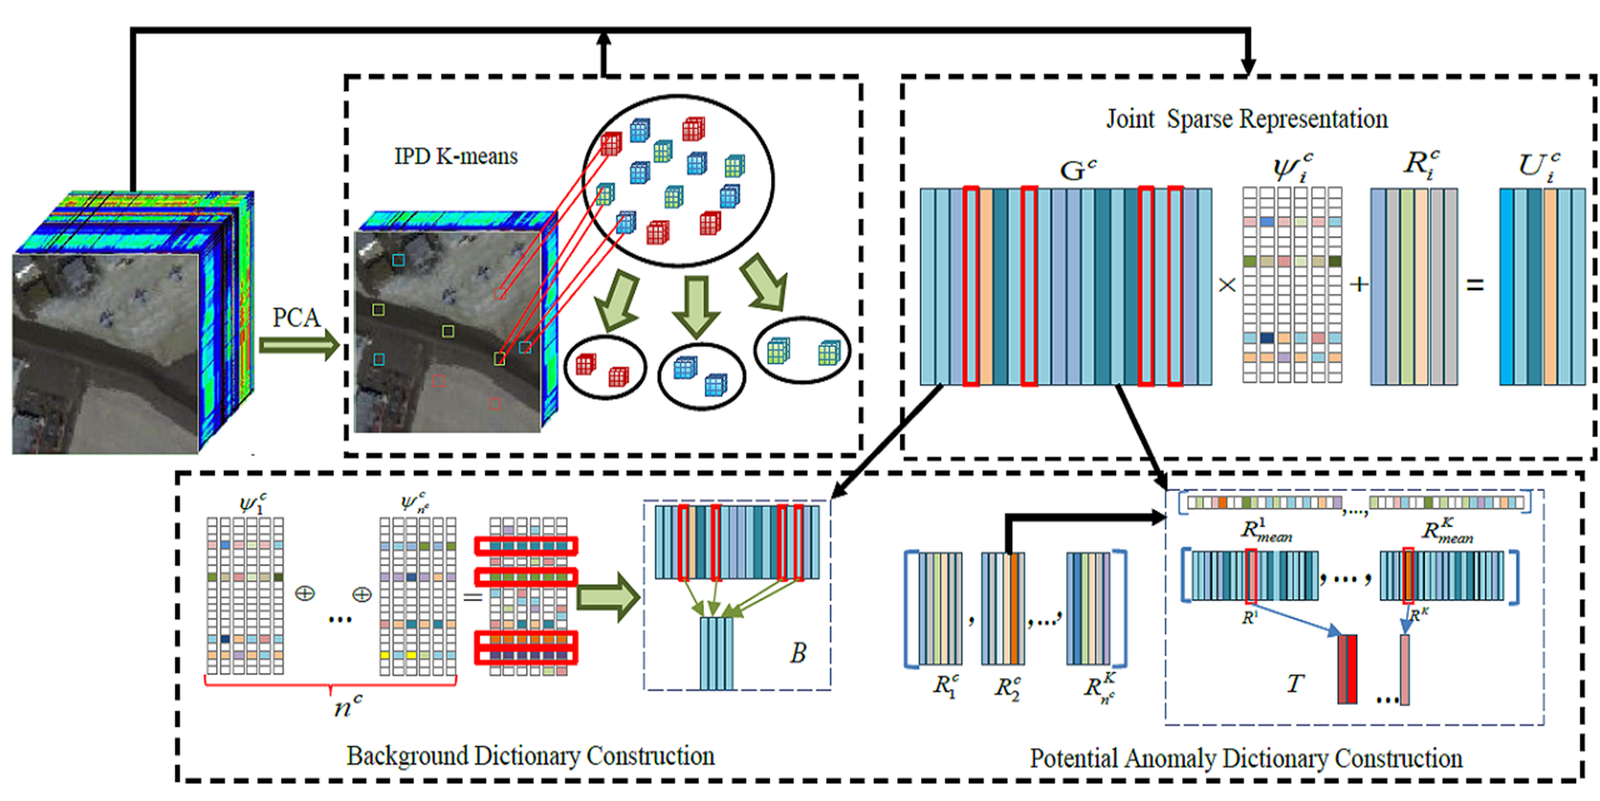
SYSTEM ARCHITECTURE

Slide 10
MODULES
Image Data collection
Image Data Processing
Dictionary construction
Detection Analysis

Slide 11
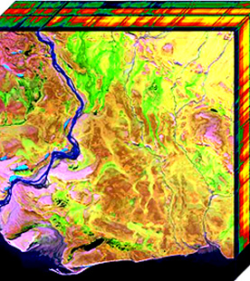
Image Data collection:
Required Data consists of Hyperspectral Image’s Hyper Cube.
Hyperspectral Imaging is a new analytical technique based on spectroscopy.
Hyperspectral images are the images in which one continuous spectrum is measured for each pixel.
The image acquired from any HSI camera will be in the form of a hypercube, having n-dimensional image data.
Data Sources: Grupo De Inteligencia Computacional [5]
Remote Sensing Laboratory [6]

Slide 12
Image Data Processing:
The process of transforming an image into a digital form and performing certain operations to get some useful information from it.
It is a type of signal processing in which input is an image and output may be image or characteristics/features associated with that image.
For hyperspectral image processing, the values read from the data file are arranged into a three-dimensional (3-D).
The hypercube function creates a hypercube object and stores the data cube, spectral wavelengths, and the metadata to its properties.

Slide 13
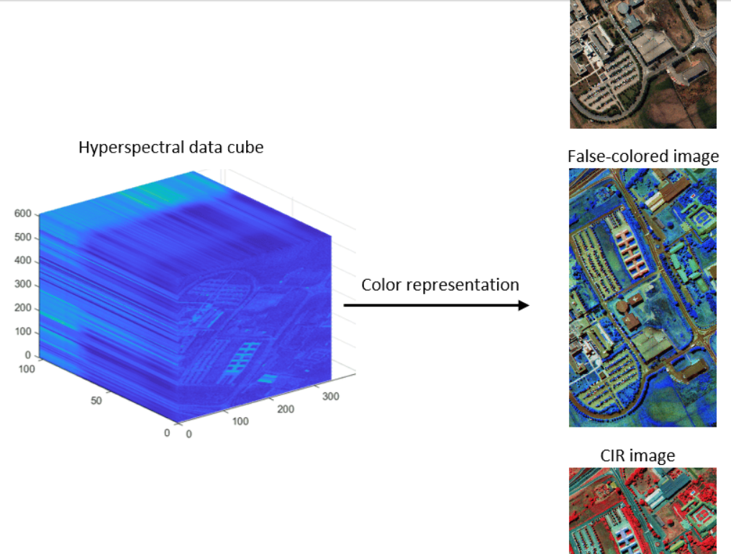
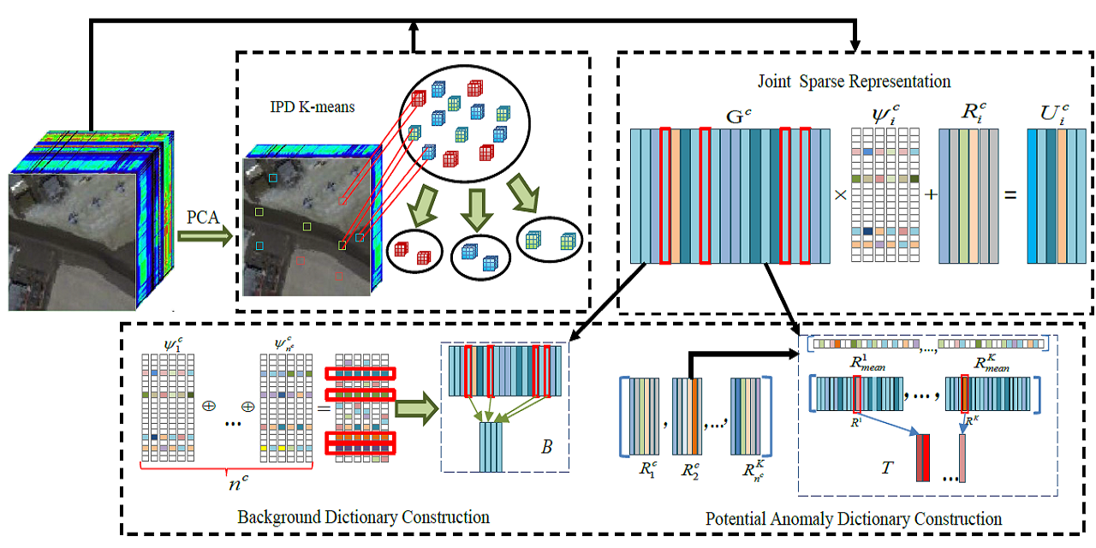


Slide 14
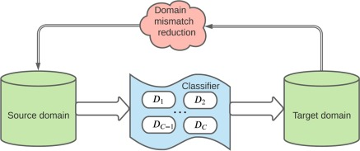
dictionary construction:
Dictionary learning is a branch of signal processing and machine learning that aims at finding a frame in which some training data admits a sparse representation.
The sparser[4] the representation, the better the dictionary.
The resulting dictionary is in general a dense matrix.
We construct the Background and Potential anomaly dictionaries.

Slide 15


Slide 16
Detection Analysis:
ROC Curve:
An ROC curve (receiver operating characteristic curve) is a graph showing the performance of a classification model at all classification points.
This curve plots two parameters:
      True Positive Rate
      False Positive Rate
AUC Value:
AUC represents the probability that a random positive example is positioned to the right of a random negative example.
AUC measures the entire two-dimensional area underneath the entire ROC curve from (0,0) to (1,1).

Slide 17
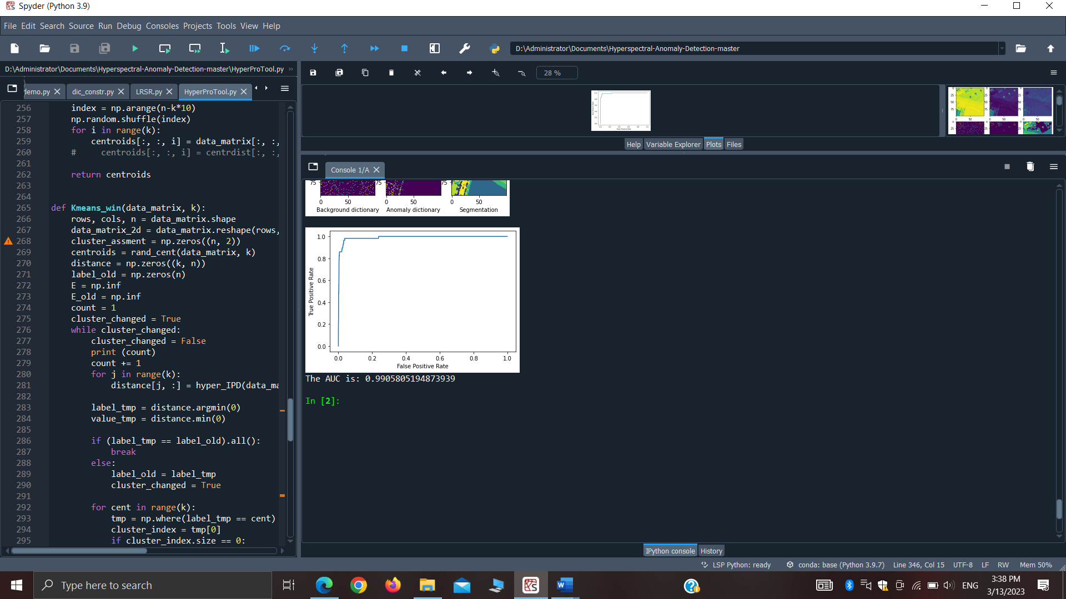
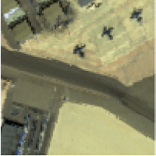
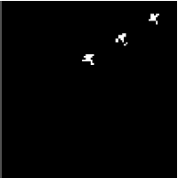

Slide 18
UML DIAGRAMS
An UML diagram is a partial graphical representation (view) of a model of a system under design, implementation, or already in existence.
UML diagram contains graphical elements (symbols) - UML nodes connected with edges (also known as paths or flows) - that represent elements in the UML model of the designed system.

Slide 19
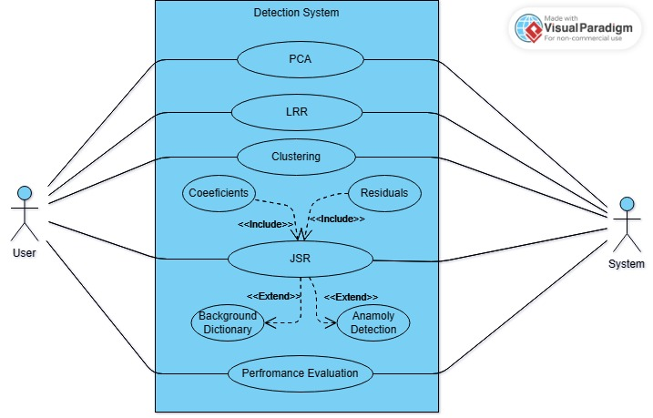
USECASE DAIGRAM
A use case diagram can summarize the details of your system's users (also known as actors) and their interactions with the system.

Slide 20
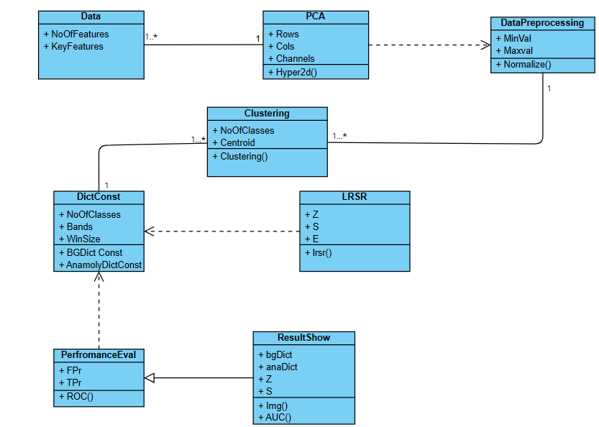
CLASS DIAGRAM
A Class diagram is a type of static structure diagram that describes the structure of a system by showing the system's classes, their attributes, operations and the relationships among objects.

Slide 21
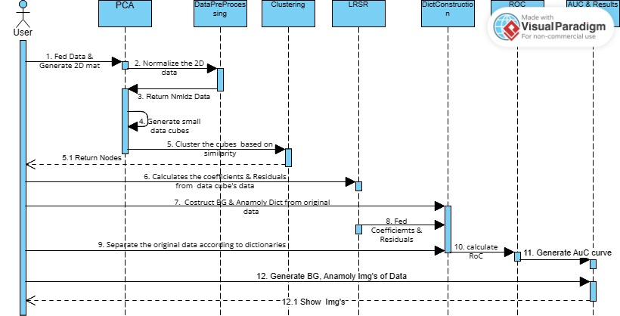
SEQUENCE DIAGRAM
A sequence diagram is a type of interaction diagram because it describes how and in what order a group of objects works together.

Slide 22
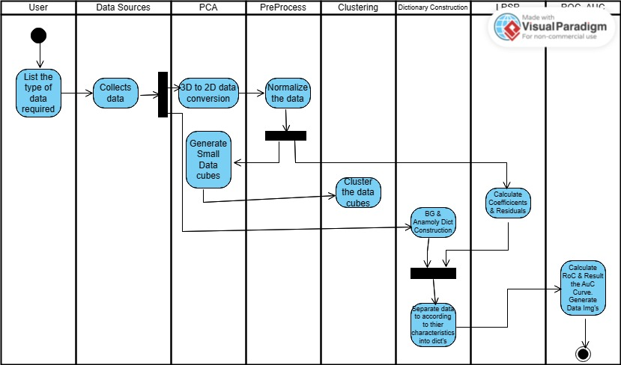
ACTIVITY DIAGRAM
An activity diagram portrays the control flow from a start point to a finish point showing the various decision paths that exist while the activity is being executed.

Slide 23
CONCLUSION
So, finally we have concluded that during the project development, we had learnt many key things of Statistical and Experimental concepts . And also, it is very important of each minor work piece to carry out the model accurately to yield the results.

Slide 24
FUTURE SCOPE
For future extension, On the basis of future scope Hyperspectral Image Sensing & Its anomaly detection, we can integrate the work that done now with the deep learning and enhanced deep learning in order to classify the pixels more accurately according to similar classes to provide the ideal accuracy. Not only with DL, Auto-Encoding techniques might be applied to transform the data as convenient to implement the model on data.

Slide 25
REFERENCES
D. Landgrebe, “Hyperspectral image data analysis,” IEEE Signal Process. Mag., vol. 19, no. 1, pp. 17–28, Jan. 2002.
F. Luo, B. Du, L. Zhang, L. Zhang, and D. Tao, “Feature learning using spatial-spectral hypergraph discriminant analysis for hyperspectral image,” IEEE Trans. Cybern., vol. 49, no. 7, pp. 2406–2419, Jul. 2019.
Y. Chen, N. M. Nasrabadi, and T. D. Tran, “Hyperspectral image classification using dictionary-based sparse representation,” IEEE Trans. Geosci. Remote Sens., vol. 49, no. 10, pp. 3973–3985, Oct. 2011.
R. Zhao, B. Du, and L. Zhang, “Hyperspectral anomaly detection via a sparsity score estimation framework,” IEEE Trans. Geosci. Remote Sens., vol. 55, no. 6, pp. 3208–3222, Jun. 2017.
Hyperspectral Remote Sensing Scenes - Grupo de Inteligencia Computacional (GIC) (ehu.eus)
Data - rslab (ut.ac.ir)

